Slide 1





FAKE JOB DETECTION USING ARTIFICIAL INTELLIGENCE
By Visesh Bentula and Adilakshmi Chimakurthi

Slide 2
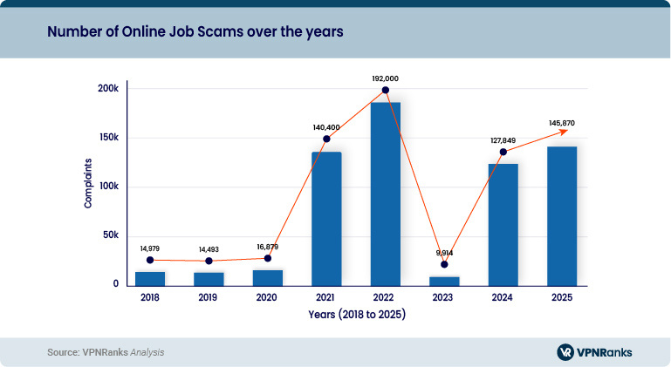
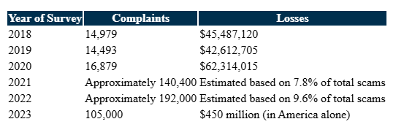
ONLINE JOB SCAMS: RISING THREAT AND FINANCIAL IMPACT
Online job scams are becoming a serious global issue, targeting job seekers with fake offers that steal personal data, demand payments, or exploit sensitive information.
🔹 Why This Matters:
Job seekers are increasingly vulnerable, especially during times of economic uncertainty or mass unemployment.
Scammers use fake company profiles and professional-sounding job ads to deceive applicants.
Victims often suffer financial losses, identity theft, or emotional distress.
🔹 The Need for an AI-Based Solution:
Manual detection of fake jobs is slow and unreliable.
Our AI tool analyzes job descriptions and company profiles to automatically flag suspicious postings.
It helps reduce fraud, protect users, and build trust on job platforms.
With job scams rising sharply every year, proactive detection using AI is no longer optional—it’s essential.
AN ANALYSIS OF THE DATA REVEALS A CONCERNING UPWARD TREND IN ONLINE JOB SCAMS OVER RECENT YEARS. THE NUMBER OF COMPLAINTS AND ASSOCIATED FINANCIAL LOSSES HAS BEEN RISING STEADILY:

Slide 3
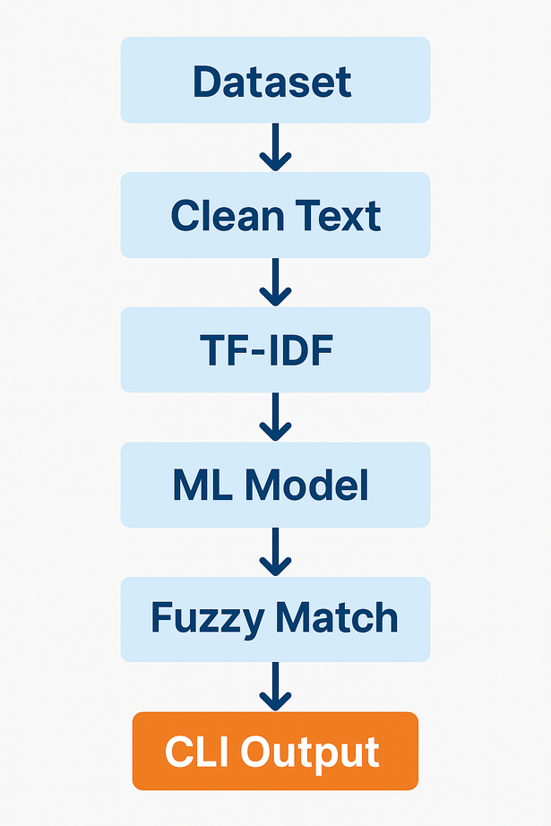
METHODOLOGY / RESEARCH APPROACH
The project uses a hybrid NLP + ML approach to detect fake job postings based on textual patterns in company_profile.
Key Phases:
Data Collection: Use of labeled job postings from Kaggle
Text Preprocessing: Clean and normalize input using regex and NLP steps
Feature Extraction: Convert text into numeric vectors using TF-IDF
Model Training: Apply supervised algorithms — Logistic Regression & Random Forest
Fuzzy Matching: Incorporate string similarity to allow dynamic prediction input
Interactive CLI: User-friendly terminal interface for real-time prediction and model retraining
Why this approach works:
Leverages proven ML techniques for classification
TF-IDF captures important patterns in job descriptions
Interactive updates allow continuous model improvement

Slide 4
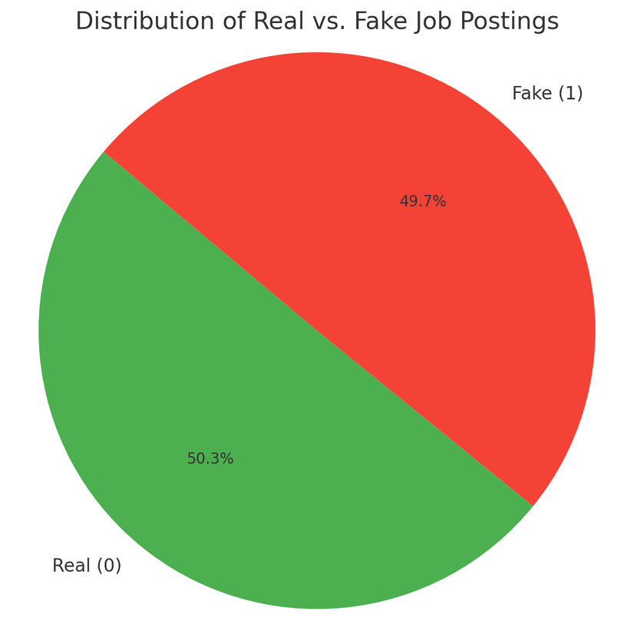
DATASET OVERVIEW
Source: Kaggle Dataset – “Fake Job Postings”
Original Data: Approximately 10,000 fraudulent job postings
URL: https://www.kaggle.com/datasets/srisaisuhassanisetty/fake-job-postings?resource=download
Issue: The dataset was significantly imbalanced, primarily consisting of fake entries
Solution: Introduced around 10,000 synthetic legitimate job postings to achieve balance
**Final Distribution**:
Real (0): 10,103 entries (50.3%)
Fake (1): 10,001 entries (49.7%)
Key Columns: title, description, requirements, company_profile, and more
Project Focus: Utilized only the company_profile text for detecting fraud
User-Extensible: New company profiles can be added and retrained dynamically
🧠 Insight: Balancing the dataset was crucial to avoid model bias in predicting fraud. The inclusion of synthetic real data ensured fairness throughout the training process.

Slide 5
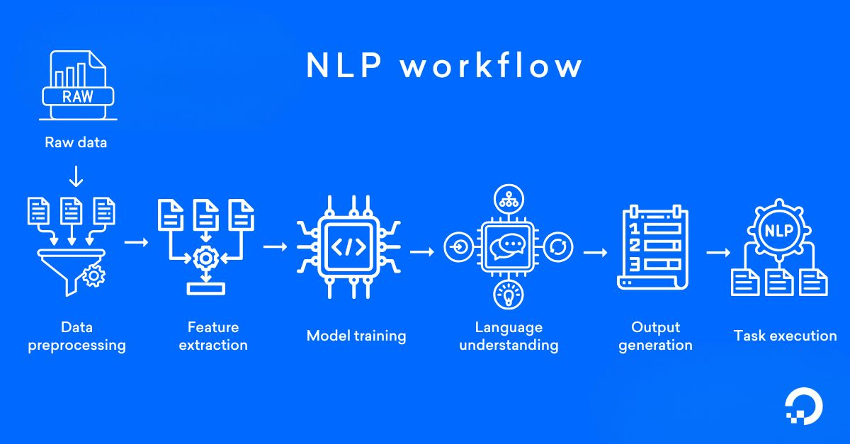
WHAT IS NLP & WHY IT MATTERS ?
🔹 What is NLP (Natural Language Processing)?
NLP is a branch of Artificial Intelligence (AI) that enables machines to read, interpret, and understand human language.
It allows systems to process unstructured text data like job descriptions, resumes, or company profiles and extract meaningful patterns.
🔹 Why NLP Matters in Fake Job Detection:
Job postings are written in natural language, not code or numbers.
Identifying fraud depends on how companies describe themselves.
NLP bridges the gap between raw text and machine understanding, enabling intelligent decision-making.
Notes:
Now let’s talk about a core component of this project — Natural Language Processing, or NLP.
NLP is the field of AI that deals with understanding and working with human language. In our case, it enables the system to analyze the company_profile text from job postings — which is unstructured, free-form text — and convert it into something a machine learning model can learn from.
The image you see here shows a typical NLP workflow, which mirrors what happens in our project as well.
First, we start with raw data — this is just the company profile text as collected from the dataset.
Second, the system performs data preprocessing. This means cleaning the text: removing punctuation, converting everything to lowercase, and getting rid of any unnecessary symbols. This step ensures consistency and removes noise.
Third, we move to feature extraction. We use a method called TF-IDF to convert cleaned text into numerical vectors that represent the importance of words. These vectors become the input for our machine learning models.
Fourth, we perform model training. We apply supervised learning, which means training on examples labeled as real or fake jobs. The model learns to recognize subtle linguistic patterns that might indicate fraud.
Fifth, after training, the model reaches a stage of language understanding. It can now interpret new company profiles and judge their legitimacy based on what it has learned.
Sixth, we have output generation. The model gives us a prediction: is the job real or fake? It also outputs a confidence score.
And finally, task execution. Based on the prediction, the system displays the result in the CLI, and the user can interact further — for example, by adding new companies to the dataset for retraining.
So, to summarize: NLP is the foundation that allows our tool to handle text intelligently. Without it, we wouldn’t be able to turn job descriptions into something our models can analyze."

Slide 6
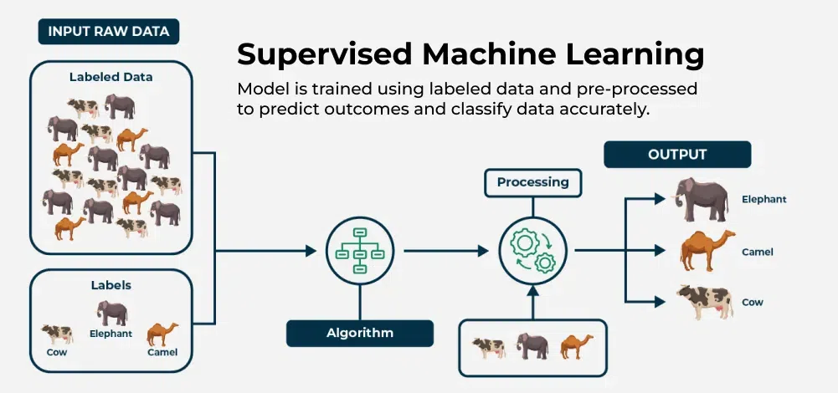
SUPERVISED ML
🔹 What is Supervised Machine Learning (SML)?
Supervised ML is a training approach where the model learns from labeled data that is, data with known outcomes. In our case, each company profile is labeled as either a real (0) or fake (1) job posting. The model uses this information to learn patterns and create a decision boundary that can classify new, unseen entries.
🔹 Why is SML Suitable for This Project?
Fake job detection is a classic binary classification problem. Since the dataset already contains labeled examples, supervised learning is ideal. It allows us to evaluate performance using real world metrics like accuracy and precision, and the models can be easily retrained when new labeled data is added through user input.
🔹 Models Implemented
We used two supervised ML models:
• Logistic Regression – A linear model that is easy to interpret and works well when the separation between real and fake postings is straightforward.
• Random Forest – An ensemble method that builds multiple decision trees and combines them for a more accurate and robust prediction, especially effective for capturing non linear relationships in the data.
🔹 Dealing with Class Imbalance
While our dataset is fairly balanced, some slight variation exists. To avoid biasing the model toward the majority class, we used class_weight='balanced' in both models. This adjusts the learning process so that misclassifying fake jobs is penalized just as heavily as misclassifying real ones.

Slide 7
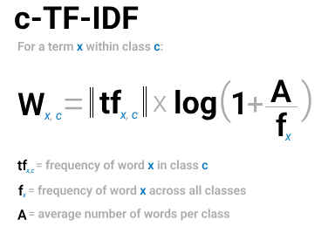
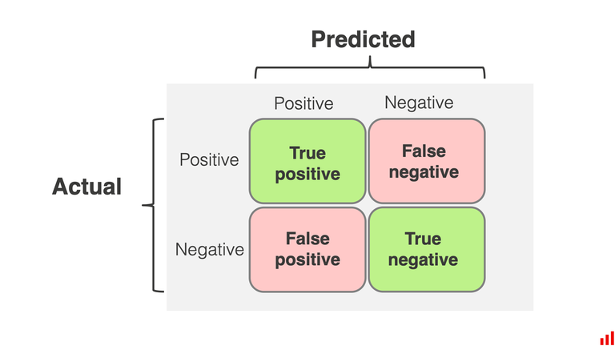
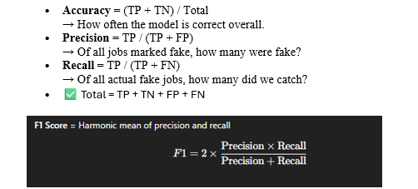
TF-IDF AND CONFUSION MATRIX
🔹 TF-IDF (Term Frequency–Inverse Document Frequency)
Transforms raw text into numerical vectors based on word significance.
Highlights rare yet meaningful words (e.g., “payment”, “confidential”).
Reduces the weight of common words that appear in most profiles.
Enables machine learning models to distinguish between real and fake patterns.
🔹 Confusion Matrix:
Summarizes prediction results by comparing actual vs. predicted labels.
True Positive (TP): Correctly predicted fake job
True Negative (TN): Correctly predicted real job
False Positive (FP): Real job wrongly flagged as fake
False Negative (FN): Fake job missed as real
Helps derive evaluation metrics like accuracy, precision, recall, and F1-score.

Slide 8
NLP-DRIVEN CLASSIFICATION FLOW
🔹 1. Preprocessing & Cleaning
The raw company profile text undergoes preprocessing where special characters are removed, everything is converted to lowercase, and whitespace is normalized. This step ensures the input is clean, consistent, and ready for analysis.
🔹 2. TF-IDF Vectorization
Cleaned text is converted into TF-IDF vectors a numerical representation of how important each word is in distinguishing between fake and real job postings. This turns unstructured text into machine-readable features.
🔹 3. Model Training
The TF-IDF vectors are fed into supervised learning models Logistic Regression and Random Forest trained on labeled examples. Both models are adjusted for class imbalance to ensure fair treatment of both real and fake samples.
🔹 4. Prediction & Output
After training, the system can take new company profiles and predict whether they are likely real or fake. It also provides a fraud probability score and uses fuzzy matching to find the closest known company in the dataset.

Slide 9
IMPLEMENTATION – DATA PREPARATION & VECTORIZATION
🔹 Label Selection & Cleaning:
df['label'] = df['fraudulent']
df = df[['company_profile_clean', 'label']]
Focuses the dataset only on what's needed: cleaned company profile + binary label.
Ensures the model doesn't learn from irrelevant fields like title or location.
🔹 Vectorization with TF-IDF:
vectorizer = TfidfVectorizer(max_features=3000)
X = vectorizer.fit_transform(df['company_profile_clean'])
Converts text into numerical vectors capturing word importance.
max_features=3000 limits vocabulary size for memory efficiency and generalization.
🔹 Handling Edge Cases:
if len(value_counts) < 2 or value_counts.min() < 2 :
This checks if:
Only 1 class is present (e.g., only real jobs, no fake jobs)
Or one class has fewer than 2 samples (too small to split)
If dataset lacks balanced classes, model is trained on entire data.
This avoids errors or overfitting during train-test split.
If either is true, the code prints a warning and skips the train-test split. (In our case, both conditions are false, so we safely proceed with splitting)
🔹 Train-Test Split (if balanced):
X_train, X_test, y_train, y_test = train_test_split(..., stratify=y)
Uses stratified sampling to maintain the fraud/real ratio.
Ensures a fair and representative test set for performance evaluation.
Notes:
This slide covers the first part of the backend logic — where we prepare the data and convert it into a form that the model can understand.
First, we focus only on the relevant columns: the cleaned company profile and its label — which is either real (0) or fake (1). This simplifies the dataset for training.
Next, we apply TF-IDF vectorization. It transforms each cleaned company profile into a high-dimensional numerical vector. The idea is to give more weight to words that are unique to a document and less weight to common words across all documents. {"In this step, we used something called TF-IDF, which turns each company’s profile text into a list of numbers. These numbers tell us how important each word is in that specific profile, compared to how often it appears in the whole dataset.
Now, you might wonder: why did we pick only 3,000 words?
That’s because if we use every single word, the computer ends up with a giant matrix, full of unnecessary or rare words that don’t help in deciding if a job is real or fake. So instead, we tell it: 'Hey, just keep the top 3,000 most important words.'
This makes things faster, simpler, and avoids confusing the model with too many useless details."}
We also check if the dataset is balanced. If one class — say, fake jobs — has fewer than two entries, we skip the train-test split and train on the whole dataset to avoid instability.
If the class distribution is healthy, we perform an 80/20 split using stratified sampling, so both real and fake jobs are equally represented in both sets.”

Slide 10
MODEL TRAINING, EVALUATION & STORAGE
🔹 Train Logistic Regression & Random Forest:
lr = LogisticRegression(..., class_weight='balanced')
rf = RandomForestClassifier(..., class_weight='balanced')
Two models trained in parallel:
Logistic Regression: Linear, fast
Random Forest: Non-linear, robust
class_weight='balanced' ensures equal focus on both classes even if dataset is imbalanced.
🔹 Evaluate Models:
classification_report(), confusion_matrix(), accuracy_score()
Prints accuracy, precision, recall, and F1-score.
Gives insights into both models’ strengths and weaknesses.
🔹 Save Confusion Matrices as Images:
ConfusionMatrixDisplay(...).savefig(...)
Saves visual metrics as .png files (confusion_matrix_lr.png, confusion_matrix_rf.png)
Helps in visual validation and reporting.
🔹 Serialize Models and Vectorizer:
pickle.dump(..., open(..., "wb"))
Saves trained models (logistic_model.pkl, random_forest_model.pkl)
Also stores TF-IDF vectorizer and known companies for fuzzy matching.
Enables instant reuse in the CLI without retraining.
Notes:
“Once we have our train and test data, we move into the training phase. Two models are trained in parallel: Logistic Regression and Random Forest. Logistic Regression is linear and interpretable, while Random Forest is a more complex ensemble model that can capture nonlinear patterns.
We also set class_weight='balanced' in both models. This is important because even slight class imbalance could bias the models.
After training, we evaluate them using several metrics: precision, recall, F1-score, and of course, accuracy. The confusion matrix gives us a breakdown of true vs. false predictions.
Then, for visual analysis, we save confusion matrices as PNG images using matplotlib. These images help demonstrate how well each model performed.
Finally, we save the trained models, the vectorizer, and the known companies using Python’s pickle module. This means we don’t need to retrain everything every time — the saved files can be reused during prediction.”

Slide 11
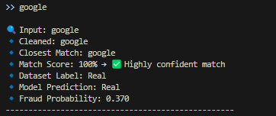
FUZZY MATCHING & PREDICTION LOGIC
🔹 SAMPLE OUTPUT IN CLI:
🔹 Why Fuzzy Matching?
process.extractOne(cleaned, known_profiles, scorer=fuzz.token_sort_ratio)
Real user input can have typos or variations (e.g., “Gooogle” vs “Google”).
fuzzywuzzy finds the closest match from the dataset using token similarity.
Scores help decide:
≥ 90 → Highly confident
80–89 → Acceptable match
< 70 → Unreliable
🔹 Prediction with Trained Model:
X_new = vectorizer.transform([cleaned])
prob = model.predict_proba(X_new)[0][1]
pred = model.predict(X_new)[0]
New input is vectorized using saved TF-IDF model.
Prediction returns:
Class: Real / Fake
Probability score: How confident the model is
🔹 Label Comparison:
dataset_label = int(label_row['fraudulent'].values[0])
If the matched company exists in the dataset, we also show the original label (for validation).
Notes:
“Now let’s look at how prediction works.
When a user enters a company name, the system doesn’t just match it literally. Instead, it uses fuzzy matching — specifically, fuzzywuzzy — to find the closest known match from the dataset. This allows for flexibility in input, accounting for spelling mistakes or formatting issues.
If a match is found and it’s confident enough — say, over 90% similarity — the model proceeds to prediction. It vectorizes the new input using the previously saved TF-IDF vectorizer, and then both the class (real or fake) and the fraud probability score are shown.
If the match is not strong enough or doesn't exist, the system offers the user an option to label the company manually. That information is then used to extend the dataset.”

Slide 12
CLI & INTERACTIVE LEARNING
🔹 Command-Line Interface (CLI):
input(">> ")
Fully text-based system — no GUI required.
User enters a company name, and the model returns predictions instantly.
🔹 On-the-Fly Data Augmentation:
add = input("Do you want to add this company?")
If company not found → user can label it manually (Real or Fake).
Added to CSV → model retrains → prediction re-attempted automatically.
🔹 Auto Retraining:
new_model, new_vectorizer = train_model(new_df)
Once a new sample is added, the training pipeline runs again behind the scenes.
Updated model reflects newly added patterns immediately.
🔹 Loop Until Exit:
while True:
user_input = input(">> ")
Keeps prompting user until they leave input blank.
Designed for continuous use during demos or evaluations.
Notes:
“All of this runs in a Command Line Interface, or CLI.
The interface is interactive and keeps prompting the user until they exit manually. This means it can be used in a loop — ideal for demos or field testing.
What’s really powerful here is the system’s ability to learn on the fly. If a new company is not in the dataset, the user can label it in real-time. The new entry is appended to the CSV, and the model retrains immediately — making it smarter with every interaction.
This makes the tool not only reactive but also proactive — capable of growing and adapting over time as more data comes in.”

Slide 13
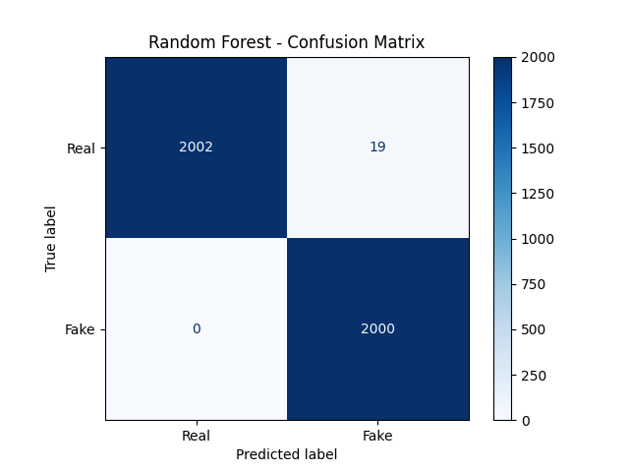
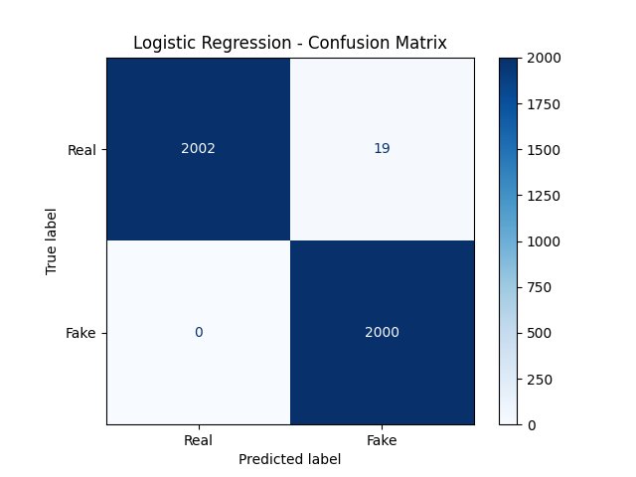
MODEL OUTPUT AND RESULTS
Both the Logistic Regression and Random Forest classifiers exhibited exceptional performance on the test set, each attaining approximately 99.52% accuracy. The Logistic Regression model achieved a precision of 99%, recall of 100%, and an F1-score of 99.5% for the fake job category. Its confusion matrix shows that 2,002 real jobs were correctly identified, while 19 were misclassified as fake, and no fake jobs were missed.
Similarly, the Random Forest model matched this performance with a precision of 99%, recall of 100%, and an F1-score of 99.5%. It also correctly identified 2,002 real jobs, with 19 false positives and no false negatives. In other words, no fake jobs were incorrectly labeled as real which aligns with the project’s core objective: to prioritize the detection of fraudulent postings, even if it means occasionally flagging a legitimate job.
This trade off is acceptable in the context of safety and risk mitigation. False positives (real jobs marked fake) can be manually reviewed, but false negatives (fake jobs marked real) could expose users to scams. Hence, this conservative bias helps prevent overfitting while ensuring that no fake job goes undetected.
In summary, both models are highly reliable. Logistic Regression provides strong, consistent precision for linear data, while Random Forest offers greater flexibility in handling complex patterns. These findings confirm the effectiveness of using TF-IDF vectorization combined with supervised learning for robust fake job detection.
Notes:
“All of this runs in a Command Line Interface, or CLI.
The interface is interactive and keeps prompting the user until they exit manually. This means it can be used in a loop — ideal for demos or field testing.
What’s really powerful here is the system’s ability to learn on the fly. If a new company is not in the dataset, the user can label it in real-time. The new entry is appended to the CSV, and the model retrains immediately — making it smarter with every interaction.
This makes the tool not only reactive but also proactive — capable of growing and adapting over time as more data comes in.”
Accuracy: 99.53% – extremely high
Precision (Fake jobs): 99% – out of all predicted fake jobs, 99% were truly fake
Recall (Fake jobs): 100% – caught all fake jobs, none slipped through
False positives: 19 real jobs wrongly flagged as fake
False negatives: 0 – very important for fraud detection

Slide 14
FUTURE WORK
🔍 Expand feature set by including additional fields like job title, description, and requirements for richer context.
🤖 Integrate advanced models such as SVM, XGBoost, or transformer-based architectures like BERT for improved text understanding.
🌐 Develop a web interface using Flask or Streamlit to make the tool accessible to non-technical users.
📡 Enable live job scraping & continuous learning to auto-detect and adapt to new fraud patterns in real-time.
Notes:
“All of this runs in a Command Line Interface, or CLI.
The interface is interactive and keeps prompting the user until they exit manually. This means it can be used in a loop — ideal for demos or field testing.
What’s really powerful here is the system’s ability to learn on the fly. If a new company is not in the dataset, the user can label it in real-time. The new entry is appended to the CSV, and the model retrains immediately — making it smarter with every interaction.
This makes the tool not only reactive but also proactive — capable of growing and adapting over time as more data comes in.”

Slide 15
THANK YOU

